Slide 1
Chiba campaign 2022
DAI YAJIE
Date：2022/11/30
Report date 2022/11/29

Slide 2
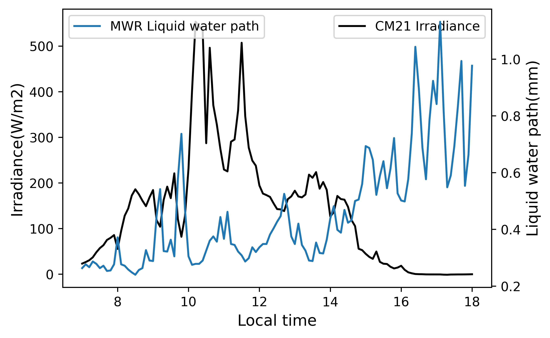
Solar radiation
2022/11/29
Cloudy&riany
Sunrise time：6:30
Sunset time：16:26

